Slide 2














Slide 3





























Slide 4


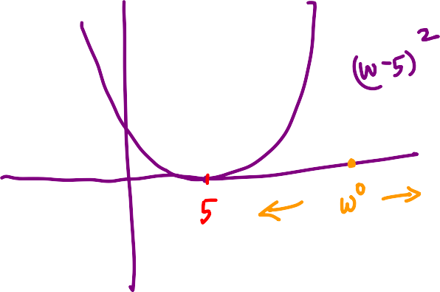
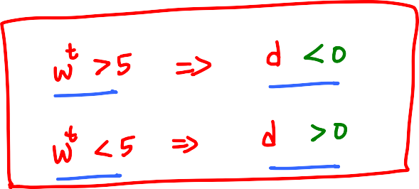















Slide 5








Slide 6
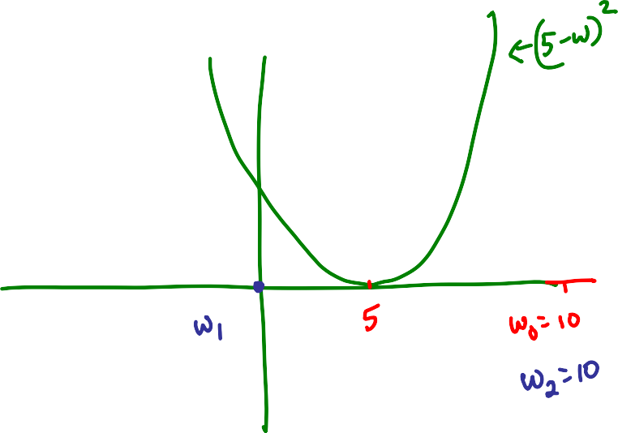












Slide 7







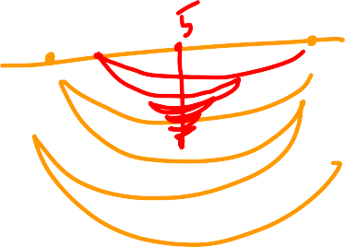















Slide 8








Reaches only a finite distance from w₀

Slide 9






















Slide 10


























Slide 11




















Slide 12








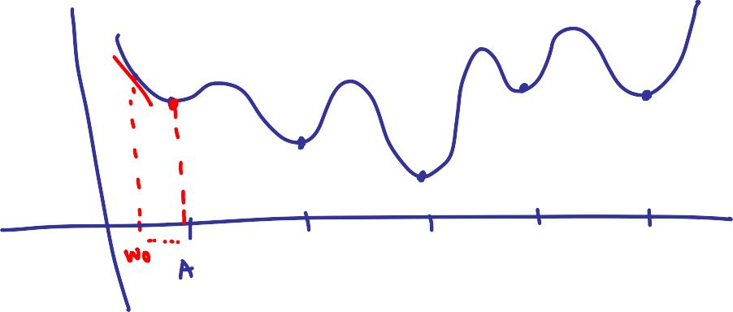

Slide 13




Slide 14














Slide 15












Slide 16



















Slide 17








Is this a valid configuration
at optimality?
∇f(w*)
∇g(w*)
There is a descent
direction which
is also feasible!
∇g(w*)^{T}d <=0
∇f(w*)^{T}d <=0
The claim
is bogus

Slide 18























Slide 19




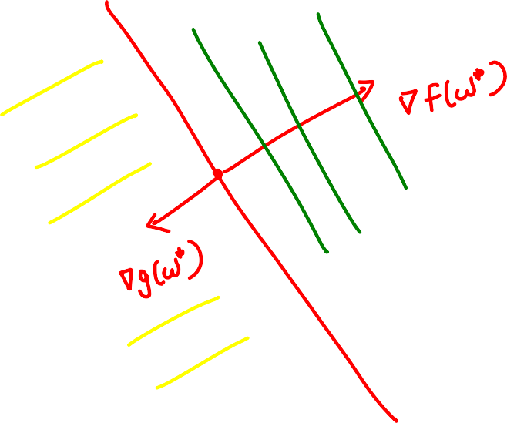




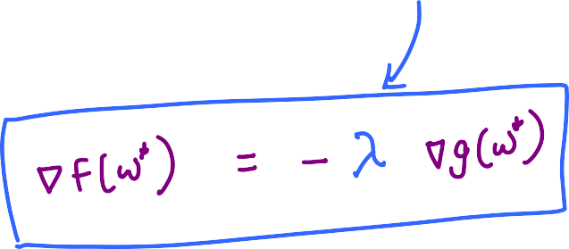











Slide 20

















Slide 21
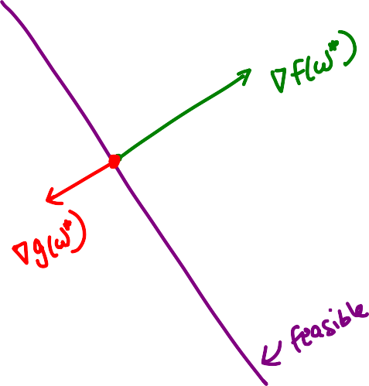






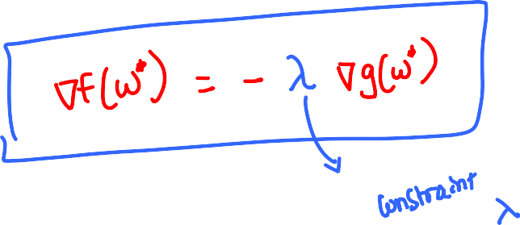






Slide 22











Slide 23













Slide 24












Slide 25








Slide 26















Slide 27




























Slide 28

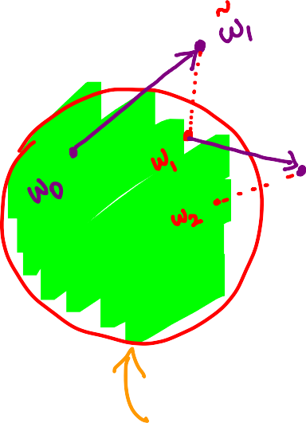
















Slide 29











